Slide 1




Model Transformation By Demonstration
Yu Sun, Jules White, Jeff Gray
CIS Dept. – University of Alabama at Birmingham ISIS - Vanderbilt University
MODELS 2009
October 9, 2009
Denver, Colorado, USA
This work funded in part by NSF CAREER award CCF-0643725.

Slide 2
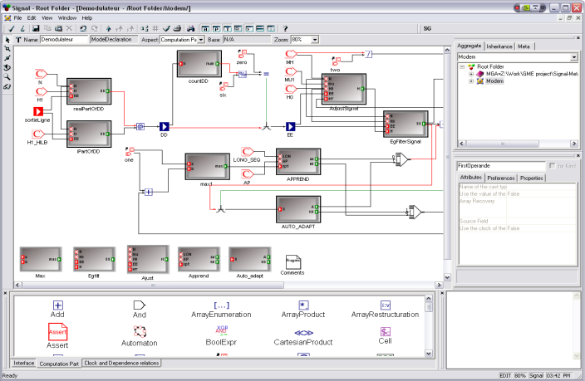
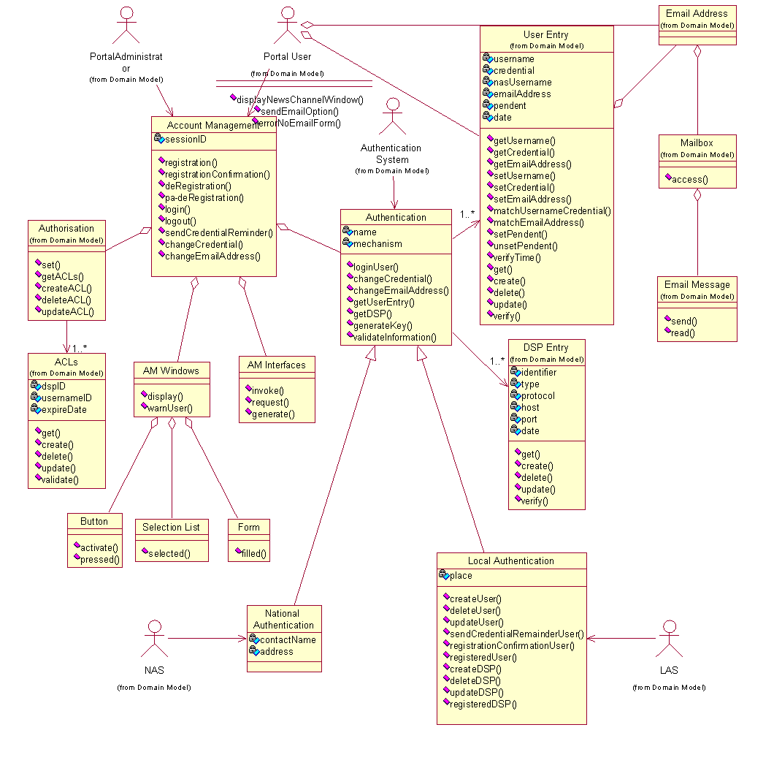
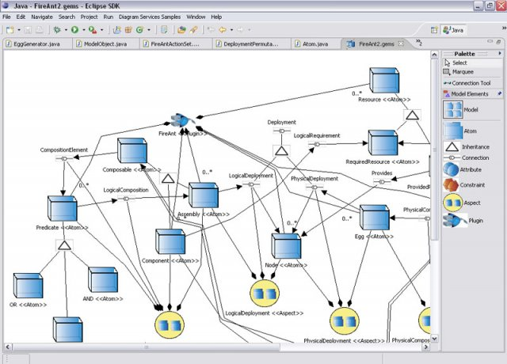
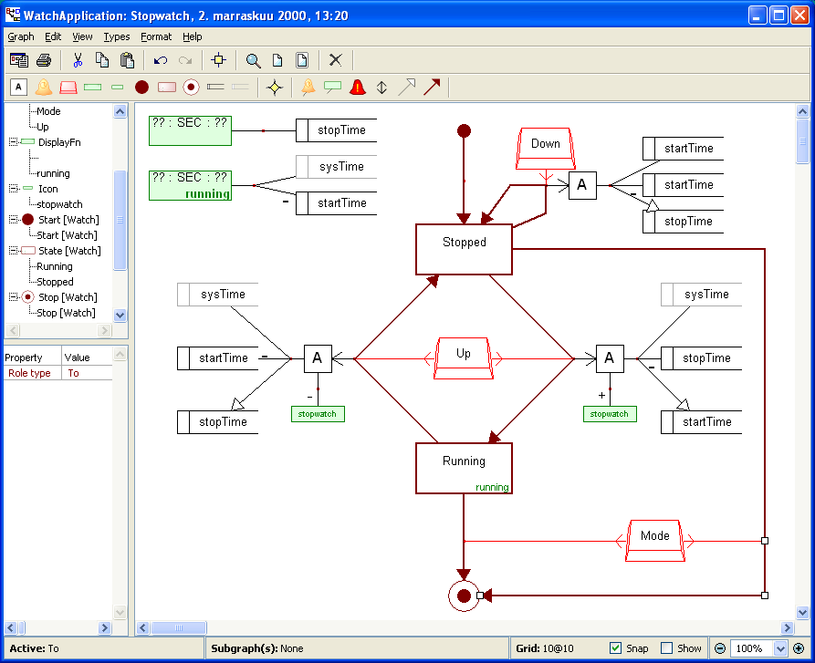
Model Transformation (MT)
A core technology in MDE & DSM

Slide 3
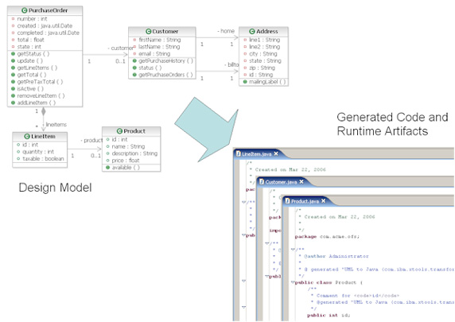
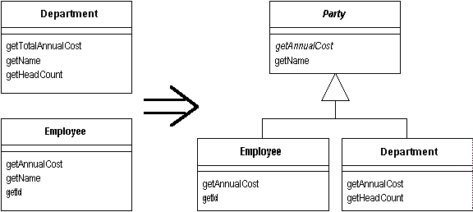
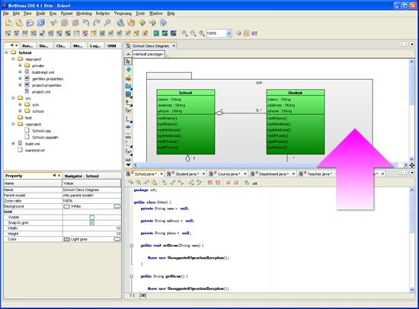
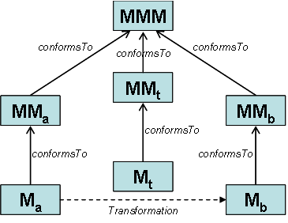
Model Transformation (MT)
A core technology in MDE & DSM
Model Evolution
Code Generation
Reverse Engineering
Model Mapping

Slide 4
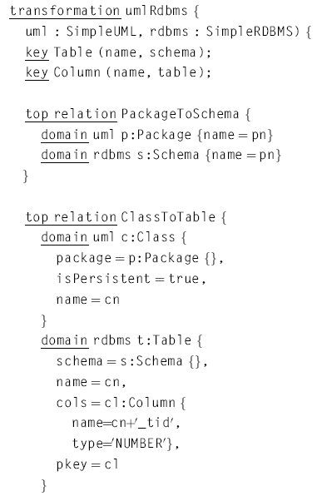
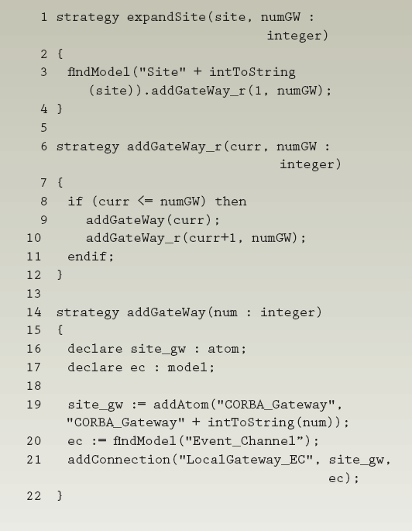
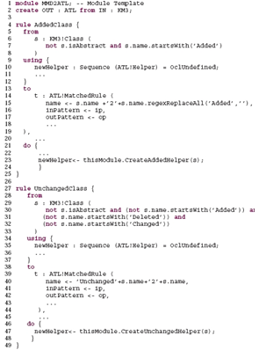
Model Transformation Languages (MTLs)
MTLs help to automate model transformations
Popular Model Transformation Languages
QVT
Query/View/Transformation
C-SAW
Constraint-Specification Aspect Weaver
ATL
ATLAS Transformation Language

Slide 5
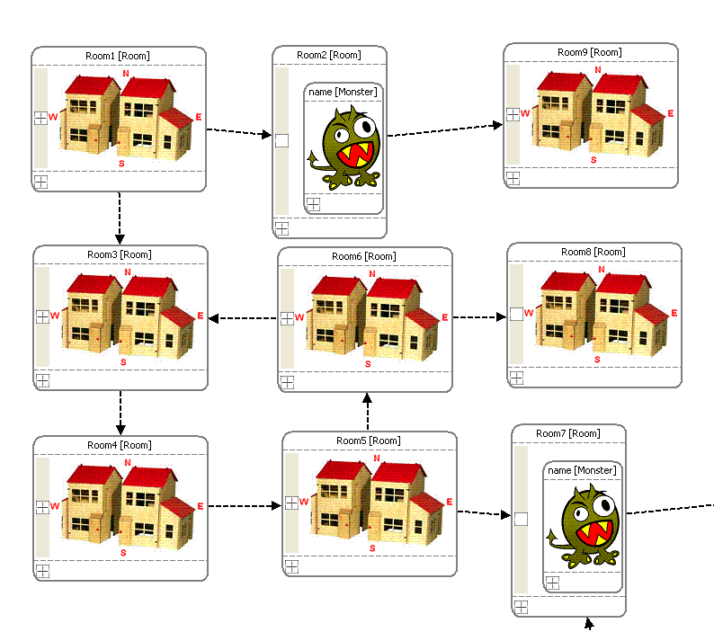
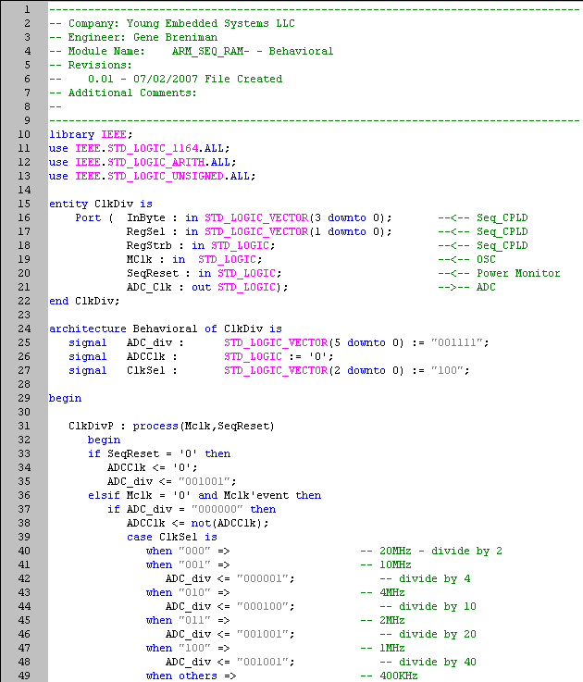
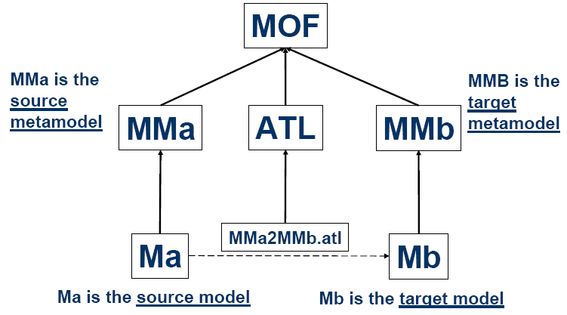
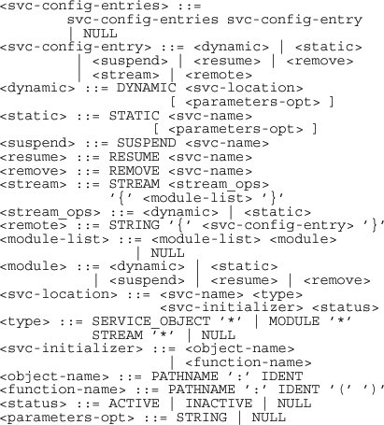
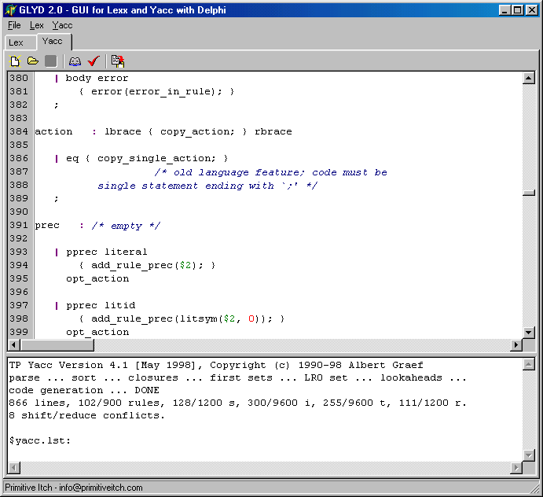
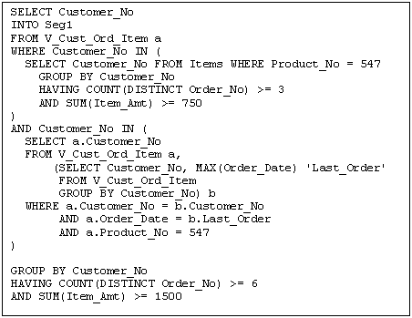
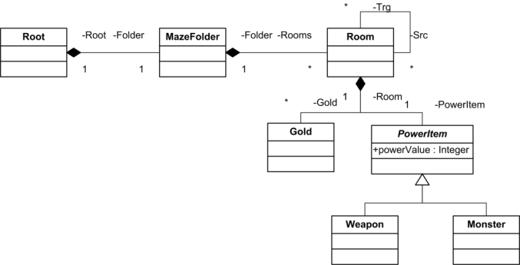
Model Transformation Languages NOT Perfect
Steep learning curve
Deep understanding about Metamodel level definition
Understand Metamodel First

Slide 6




Model Transformation Languages NOT Perfect
Steep learning curve
Deep understanding about Metamodel level definition
This is OK for computer scientists, but challenging for general users (e.g., domain experts) who can also contribute to some of the model transformation tasks

Slide 7
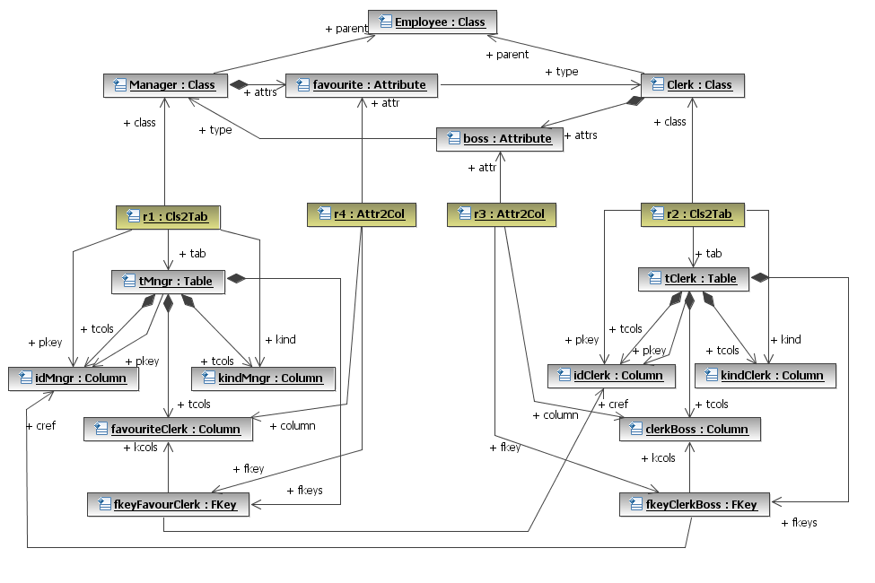
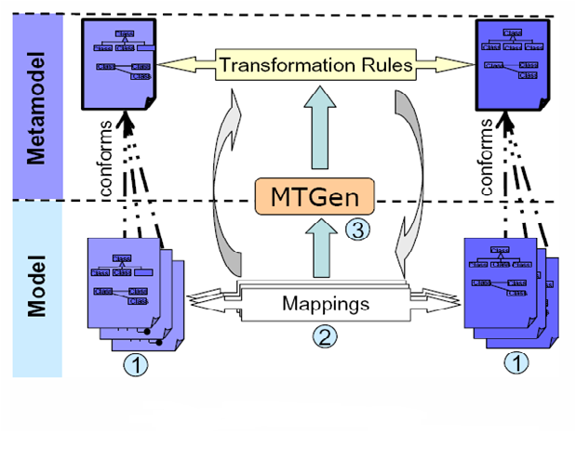
Model Transformation By Example (MTBE) [Varró, MODELS’06]
An innovative approach to simplify the implementation of model transformations
Balogh, Varró. “Model transformation by example using inductive logic programming,” Software and Systems Modeling, Vol. 8, No.3
Wimmer, Strommer, Kargl, Kramler. “Towards model transformation generation by-example,” HICSS 2007

Slide 8
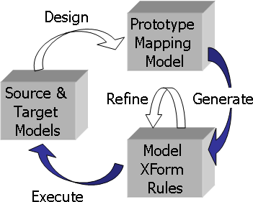
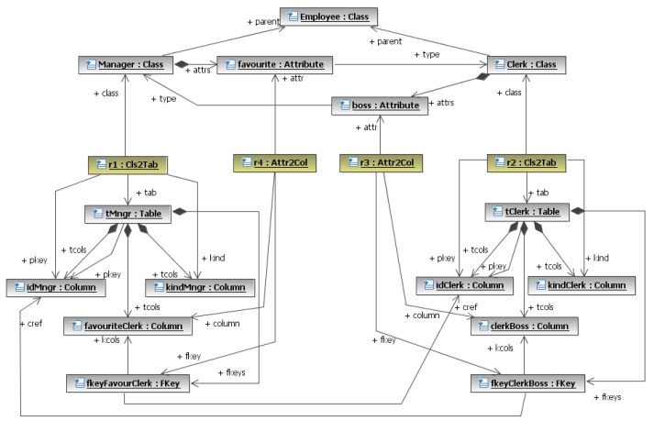
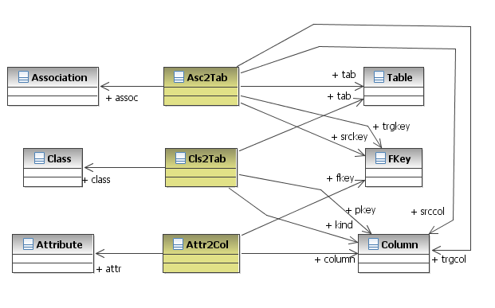
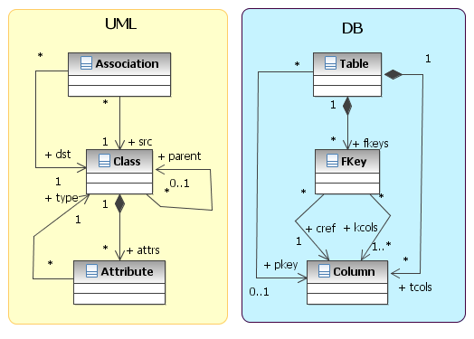
Limitations of MTBE
Semi-automatic rules generation
Code refinements might be needed. Therefore, users are not fully isolated from using the transformation languages.
The quality depends on available source and target models
Only concept mapping. Cannot handle complex attribute transformation (e.g., arithmetic, string operations)
Concepts Mapping
Perfect Source and Target Models
Balogh, Varró. “Model transformation by example using inductive logic programming,” Software and Systems Modeling, Vol. 8, No.3
Wimmer, Strommer, Kargl, Kramler. “Towards model transformation generation by-example,” HICSS 2007

Slide 9

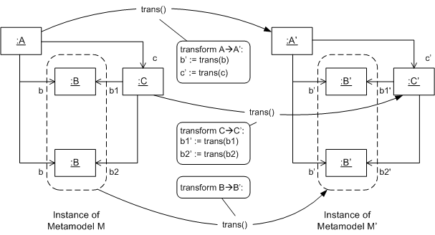
Proposed Approach – MTBD Model Transformation By Demonstration
Ask users to demonstrate how the model transformation should be done by editing a source model
An engine records user operations and infers the transformation pattern
Reuse the generated pattern to new model instances

Slide 10
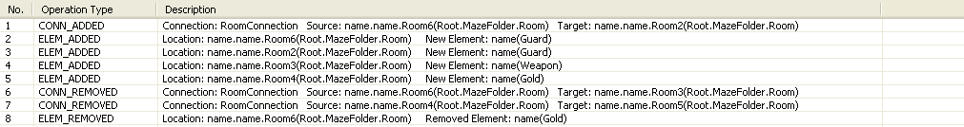
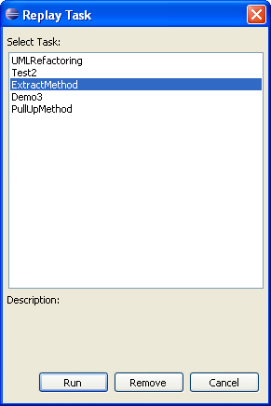
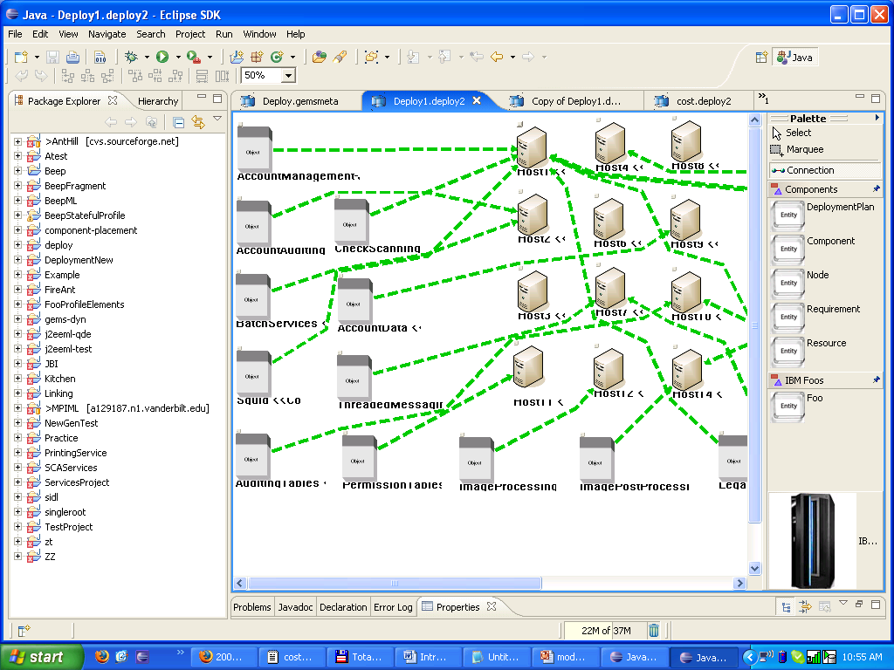

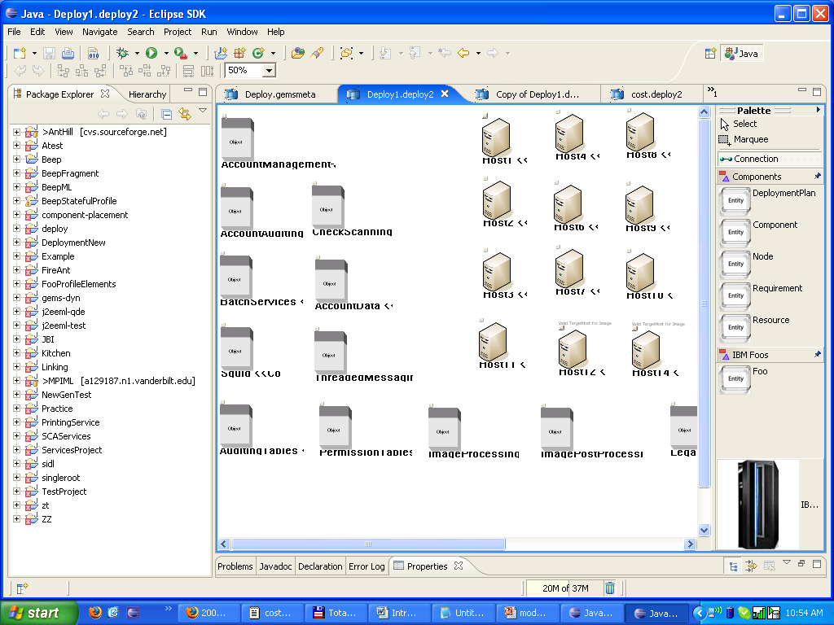
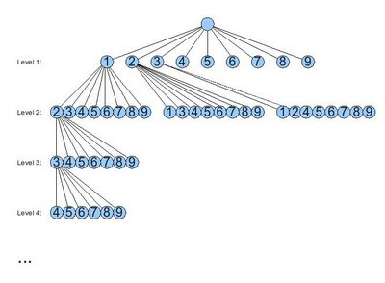
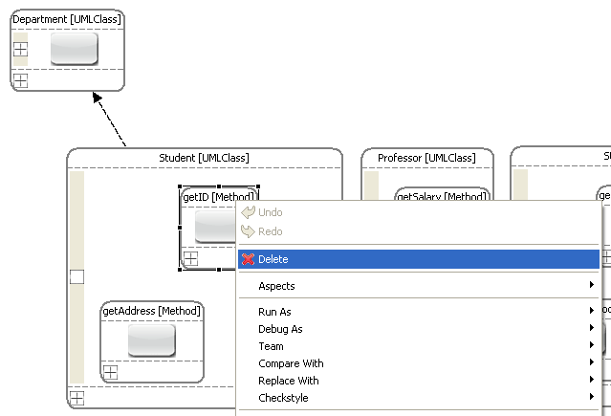
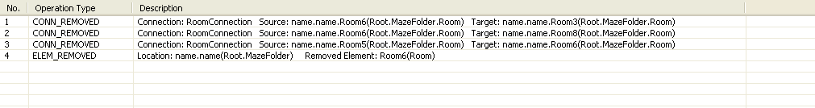



Main Steps in MTBD
Edit a model instance to demonstrate how the transformation should be done
Initial sequence of recorded operations
1. Demonstration
1. Recording
5. Correctness Checking
4. Reuse Pattern
Pattern Matching
Backtracking Algorithm
3. Infer Pattern
2. Optimization

Slide 11
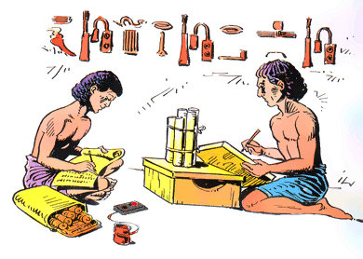

MTBD Implementation: MT-Scribe
MT-Scribe is the implementation of the MTBD idea, as realized as a plug-in to GEMS in Eclipse
Focus on Endogenous Model Transformation
i.e., transformations within the same domain (metamodel)
GEMS
Generic Eclipse Modeling System
http://www.eclipse.org/gmt/gems/

Slide 12
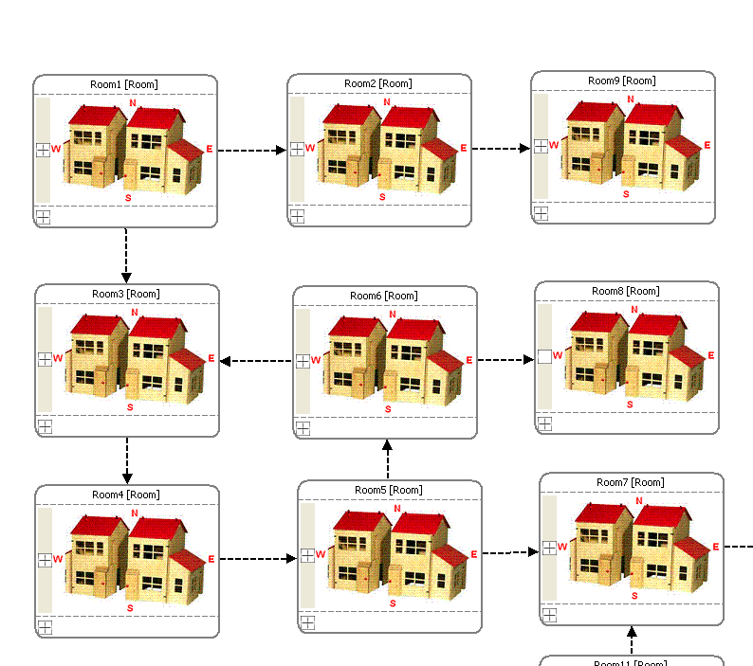
Case Study: MazeGame Refactoring
TASK:
Replace the monster
in a room with a weapon, and set the powerValue attribute of the new weapon to be half of the monster.

Slide 13
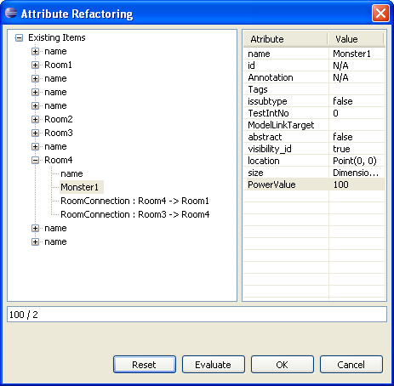
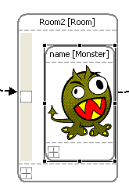
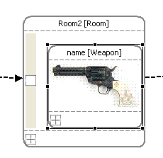
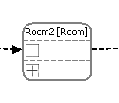
Step 1. Demonstration & Recording
Step | Operation
1
Select a Monster in a room
2
Delete the Monster
3
Add a new Weapon
4
Set the powerValue of the new Weapon

Slide 14
Step 1. Demonstration & Recording
Step | Operation
1
Select a Monster in a room
2
Delete the Monster
3
Add a new Weapon
4
Set the powerValue of the new Weapon
Recorded as follows
Step | Operation Type | Detail
1 | Delete Element | Root.MazeFolder.Room2.Monster1
2 | Add Element | Root.MazeFolder.Room2 (Weapon1)
3 | Update Element | Root.MazeFolder.Room2.Weapon1.powerValue (Root.MazeFolder.Room2.Monster1.powerValue / 2)

Slide 15
Step. 2 Operation Optimization
Eliminate meaningless operations
Step | Operation
1 | Add a Monster1 in Room2
2 | Delete the Gold1 in Room2
3 | Set the powerValue of Monster1 to be 100
4 | Connect Room2 and Room9
5 | Delete Monster1 in Room2
6 | Connect Room2 and Room10
Step | Operation
1 | Delete the Gold1 in Room2
2 | Connect Room2 and Room9
3 | Connect Room2 and Room10

Slide 16
Step. 2 Operation Optimization
Optimization Algorithm
for each op in the input operation list
switch (op.type)
case ADD:
if the element is never used in the later operations, but is removed by a
REMOVE operation later, eliminate both ADD and REMOVE operations.
case MODIFY:
if the element is used in the later operations, then keep it.
traverse the final model instance and search the element being modified
if not found then remove op from the list
if found then compare the attribute value with the value stored in op
if different then remove op from the list
… …
Step | Operation
1 | Add a Monster1 in Room2
2 | Delete the Gold1 in Room2
3 | Set the powerValue of Monster1 to be 100
4 | Connect Room2 and Room9
5 | Delete Monster1 in Room2
6 | Connect Room2 and Room10
Alternative Optimization Algorithm
Compare the initial and final models, and find out the graph differences

Slide 17
Step. 3 Infer Transformation Pattern
A transformation pattern includes:
Transformation precondition (Where)
Transformation actions (How)
Precondition (Elements needed)
elem1.elem2.elem3.elem4
elem1.elem2.elem3 (elem5)
elem1.elem2.elem3.elem5
Precondition (Elements Type)
elem1 – Root
elem2 – MazeFolder
elem3 – Room
elem4 – Monster
elem5 – Weapon
Step | Operation Type | Detail
1 | Delete Element | Root.MazeFolder.Room2.Monster1
2 | Add Element | Root.MazeFolder.Room2 (Weapon1)
3 | Update Element | Root.MazeFolder.Room2.Weapon1.powerValue (Root.MazeFolder.Room2.Monster1.powerValue / 2)
No. | Transformation Actions
1 | Remove elem4
2 | Add elem5 in elem3
3 | Set elem5.powerValue = elem4 / 2

Slide 18
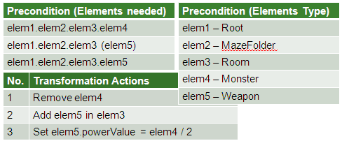
Step. 3 Infer Transformation Pattern
The advantages of using a Transformation Pattern:
Easy to implement
Independent of MTLs
Users are completely isolated from MTLs
Can be used to generate code
VS
Transformation Pattern
MTL Rules or Codes

Slide 19
Step. 4 Precondition Matching
Traverse the whole model instance and list all elements
Start to match the elements in the precondition one by one
Backtracking algorithm is used
All Elements in the Instance
Root.MazeFolder.Room1
Root.MazeFolder.Room1.Gold1
Root.MazeFolder.Room2.Monster1
Root.MazeFolder.Room2.Gold1
Root.MazeFolder.Room3
Root.MazeFolder.Room4.Weapon2
Root.MazeFolder.Room5
Root.MazeFolder.Room6.Weapon3
…
Precondition (Elements needed)
elem1.elem2.elem3.elem4
elem1.elem2.elem3 (elem5)
elem1.elem2.elem3.elem5
Precondition (Elements Type)
elem1 – Root
elem2 – MazeFolder
elem3 – Room
elem4 – Monster
elem5 – Weapon

Slide 20
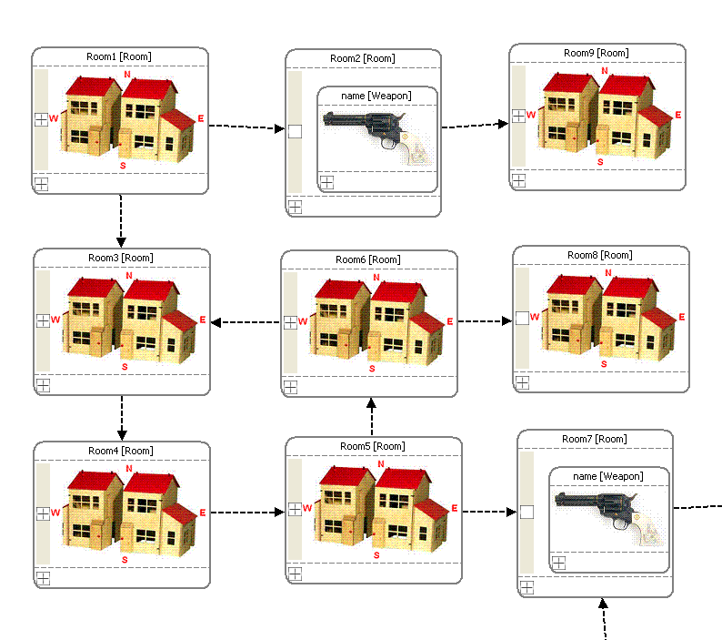
Step. 5 Executing Actions & Correctness Checking
Once a matching location is found, actions can be executed
powerValue of each weapon is also transformed

Slide 21
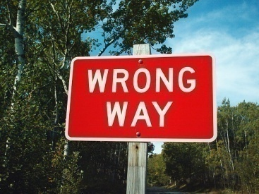

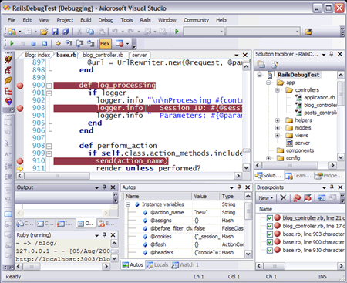
Step. 5 Executing Actions & Correctness Checking
Violation of metamodel definition is possible
Logging and undo have been implemented
It can be used to support transformation debug

Slide 22
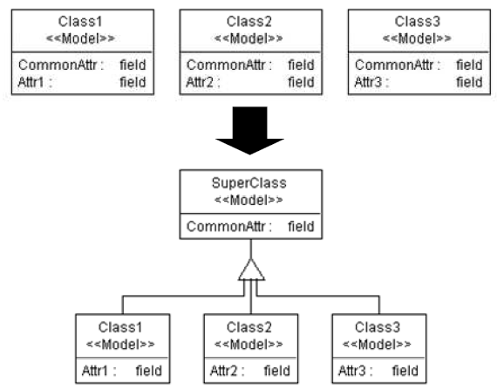
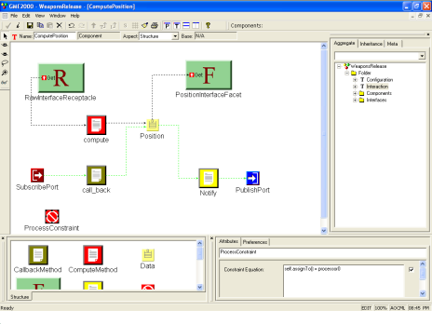
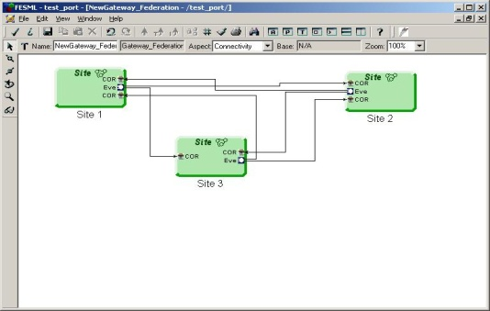
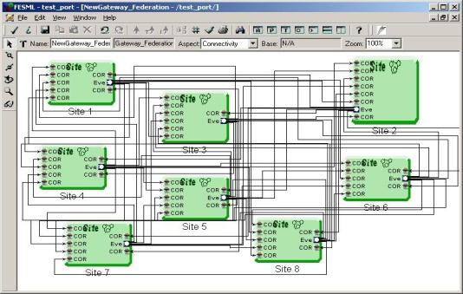
Current Status of MTBD
Automatic inference without user refinement
Independent of any MTLs
Demonstration only relies on proper source models, not target models
Handle attribute transformation in a user-friendly manner
Supports simplifying a number of endogenous MT tasks
Aspect-Oriented Modeling
Scale Up
Model Refactoring
Model Scalability

Slide 23
Current Limitations of MT-Scribe
Although fully automatic, the power is limited compared to MTLs
Unable to specify richer precondition
Precondition (Elements needed)
elem1.elem2.elem3.elem4
elem1.elem2.elem3 (elem5)
elem1.elem2.elem3.elem5
Precondition (Elements Type)
elem1 – Root
elem2 – MazeFolder
elem3 – Room
elem4 – Monster
elem5 – Weapon
What if we only want to replace the Monster (powerValue > 50)?
What if the room must be connected to at least two other rooms?

Slide 24
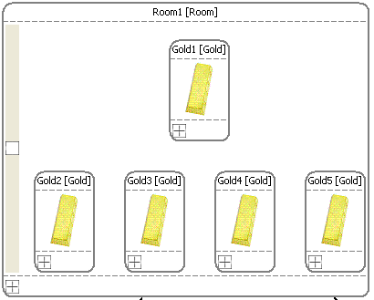
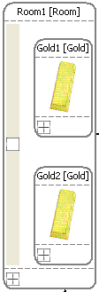
Current Limitations of MT-Scribe
Although fully automatic, the power is limited compared to MTLs
Unable to specify richer precondition
Unable to express more diverse actions
e.g. max(), min() …
Unable to express generic actions
e.g. Delete all pieces of gold in a room
Step | Operation
… | …
3 | Delete Gold1
4 | Delete Gold2
… | …
?
?
?

Slide 25
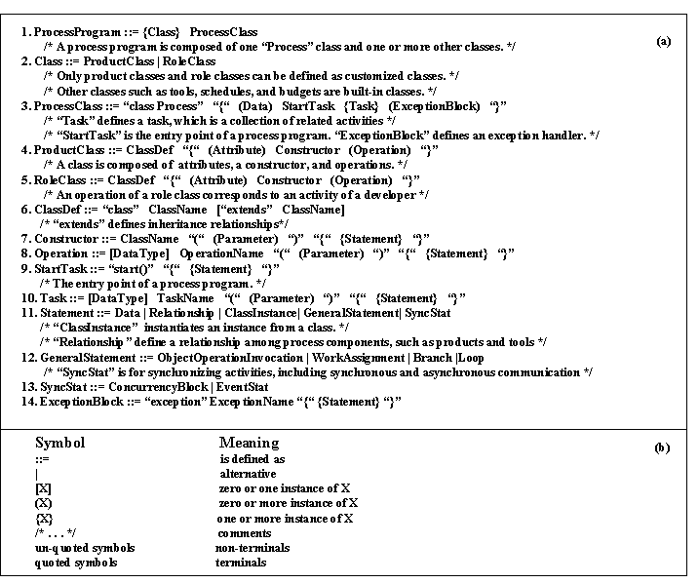


How to improve?
“Demonstration only” is not enough
Delete the two pieces of gold in a room = Delete all pieces of gold?
Set powerValue from 50 to 100 = Set powerValue * 2?
User refinement and feedback are always needed
To simplify the process, the refinement should be at the demonstration level (i.e., model instance level), not at the MTL level or metamodel level

Slide 26
Solutions
To half the powerValue (100)
Instead of typing 50, users should type 100 / 2
After the demonstration, let users specify more detailed preconditions (partially implemented)
Step | Operation Type | Detail
1 | Delete Element | Root.MazeFolder.Room2.Monster1
2 | Add Element | Root.MazeFolder.Room2 (Weapon1)
3 | Update Element | Root.MazeFolder.Room2.Weapon1.powerValue (Root.MazeFolder.Room2.Monster1.powerValue / 2)
Monster1.powerValue > 50

Slide 27
Solutions
Ask users to identify generic actions (partially implemented)
e.g. Remove all pieces of gold in a room
We want to enable everything currently not supported in a user-friendly manner, so that users do not have to know any MTLs or metamodel definitions.
Step | Operation
… | …
3 | Delete Gold1
4 | Delete Gold2
… | …
Identifying generic actions.
Independent of the number of gold.

Slide 28


Future Works
Enable user-centric refinement interface
Enable generation of transformation rules
in MTLs (e.g., ATL)
Implement exogenous model transformation

Slide 29

Questions & Comments ?
More examples and video demos available at:
http://www.cis.uab.edu/softcom/mtbd
Generic Eclipse Modeling System (GEMS)
http://www.eclipse.org/gmt/gems/
Additional questions:
yusun@cis.uab.edu
This work funded in part by NSF CAREER award CCF-0643725.

